Slide 1
Section 9: Main Memory

Slide 2
Chapter 9: Memory Management
Background
Contiguous Memory Allocation
Paging
Structure of the Page Table
Swapping
Example: The Intel 32 and 64-bit Architectures
Example: ARMv8 Architecture

Slide 3
Objectives
To provide a detailed description of various ways of organizing memory hardware
To discuss various memory-management techniques
To provide a detailed description of the Intel Pentium, which supports both pure segmentation and segmentation with paging

Slide 4
Background
Program must be brought (from disk) into memory and placed within a process for it to be run
Main memory and registers are only storage CPU can access directly
Memory unit only sees a stream of:
addresses + read requests, or
address + data and write requests
Register access is done in one CPU clock (or less)
Main memory can take many cycles, causing a stall
Cache sits between main memory and CPU registers
Protection of memory required to ensure correct operation

Slide 5
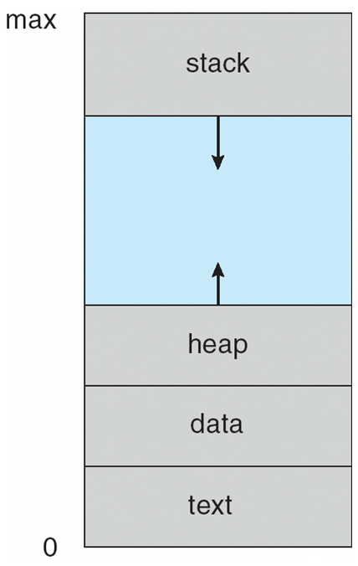
Memory Structure of a Process
A program becomes a process when it is loaded in main memory
The program code, also called text section
Data section containing global variables
Heap containing memory dynamically allocated during run time
Stack containing temporary data
Function parameters, return addresses, local variables

Slide 6
Process Address Space
Each process has a range of legal addresses
Addresses where code is stored
Addresses where data are stored
Addresses occupied by the process stack
Addresses by dynamic allocation of objects
Addresses the “whole” representing free “unoccupied” addresses for growing the stack and the heap space.
The sum of theses addresses is the address space of a process
This is a process

Slide 7
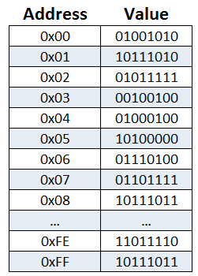
Addresses space of a process
A process is a sequence of addresses
Addresses where code is stored
Addresses where data are stored
Addresses occupied by the process stack
Addresses by dynamic allocation of objects
Addresses the “whole” representing free “unoccupied” addresses for growing the stack and the heap space.
The sum of theses addresses is the address space of a process

Slide 8
Logical vs. Physical Address Space
If 0 is the first address in the address space of each process than we can consider the address space of a process as a logical or virtual address space
Because not all processes can start at address 0
The addresses in main memory where those logical addresses are mapped is called the physical address space
While two different processes can have the same virtual address space (at least Both start at address 0), they obviously cannot have the same physical address space
So the first thing that memory management must do is to make sure that the physical address space of two process does not overlap
To separate memory spaces, we need the ability to determine the range of legal addresses that a process may access and to ensure that the process can access only these legal addresses

Slide 9
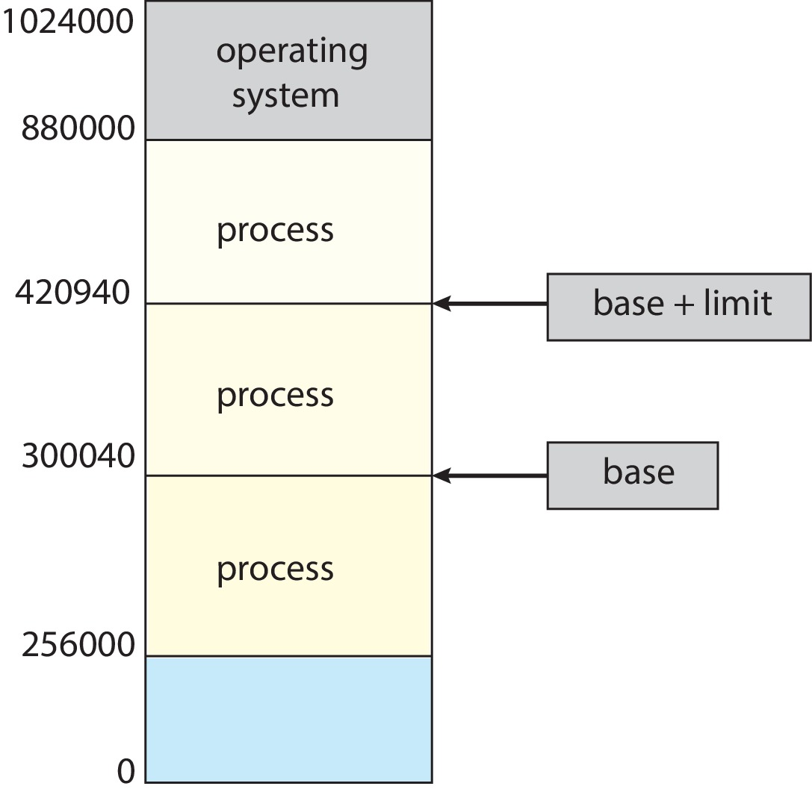
Address space protection
Need to ensure that a process can only access those addresses in its address space.
This protection is implemented using a pair of base and limit registers which define the logical address space of a process
Base register – hold the smallest legal physical memory address of a process
Limit register – specify the size of the address space of a process
Here the base register holds 300040 and the limit register is 120900, then the program can legally access all addresses from 300040 through 420939

Slide 10
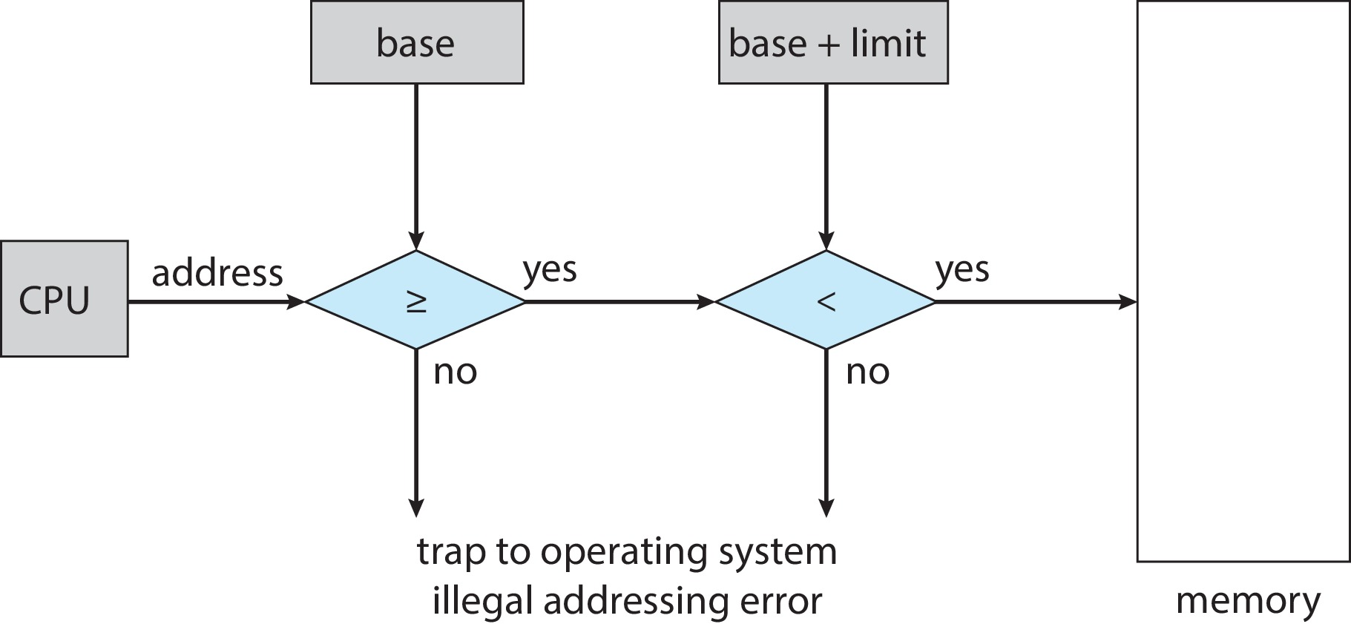
Hardware Address Protection
Logical address from 0 to 120900. Physical address of logical address 0 is 300040
Addresses in the program counter register are logical addresses. They are transformed into physical address by adding the content of the base register
Attempts to access operating-system memory or other users’ memory results in a fatal error.
Prevent a user program from modifying the code or data structures of either the operating system or other users.

Slide 11
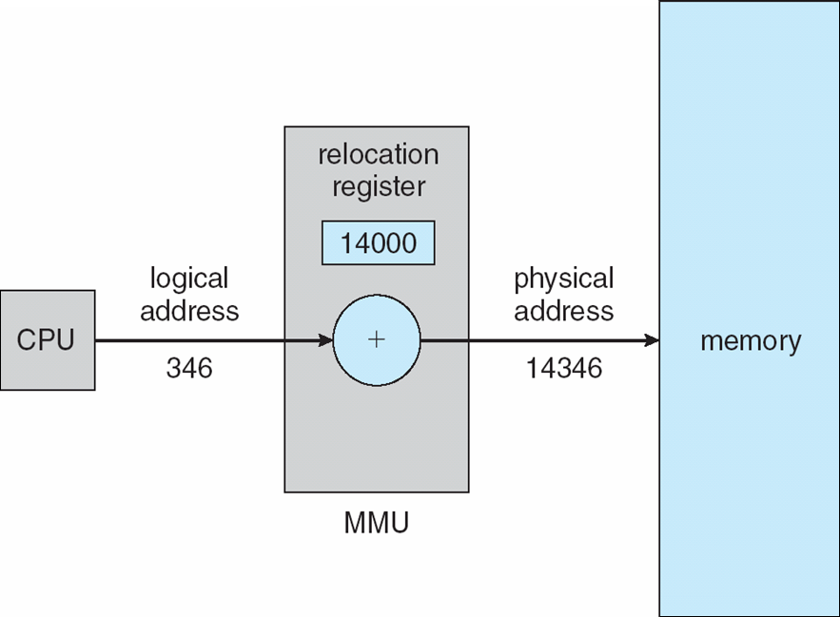
Memory-Management Unit (MMU)
The hardware device that maps virtual to physical addr is called de MMU
Here the base register is now called a relocation register. The value in the relocation register is added to every address generated by a user process at the time the address is sent to memory
If the base is at 14000, then an attempt by the user to address location 0 is dynamically relocated to location 14000; an access to location 346 is mapped to location 14346

Slide 12
Memory Allocation
Memory allocation means the set of physical addresses from main memory that are used by a process.
It is the mapping of the logical address space of a process to a set of physical addresses

Slide 13
Contiguous memory allocation
How to allocate memory to user processes?
Early method: contiguous memory allocation, each process is contained in a single contiguous section of physical memory
Use the memory management unit to compute physical addresses
There are different ways to allocate contiguously physical memory addresses, one if variable-partition

Slide 14
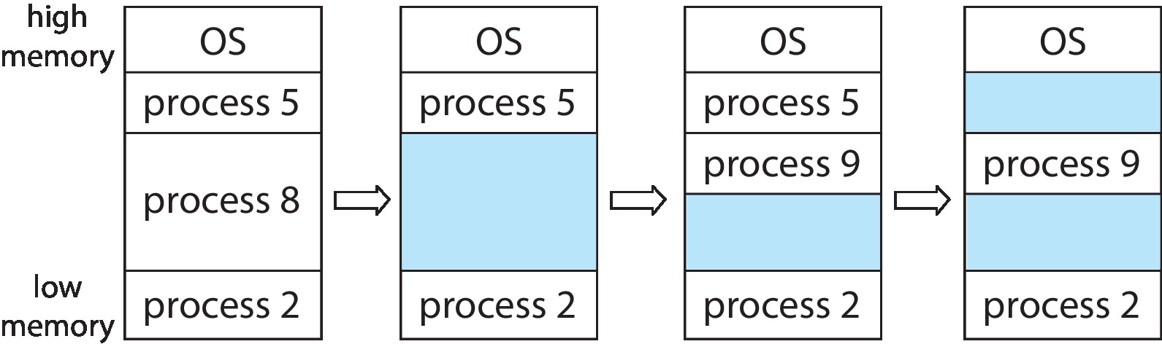
Variable Partition
Processes are stored in Holes – which are blocks of available memory of various size scattered throughout memory
When a process is loaded into main memory, it is allocated memory from a hole large enough to accommodate it
Its reallocation register is set to lowest address in the hole
Process exiting frees its partition, adjacent free partitions combined
Operating system maintains information about: a) allocated partitions b) free partitions (hole)
Degree of multiprogramming limited by number of partitions

Slide 15
Dynamic Storage-Allocation Problem
How to satisfy a request of size n from a list of free holes?
First-fit: Allocate the first hole that is big enough
Best-fit: Allocate the smallest hole that is big enough; must search entire list, unless ordered by size
Produces the smallest leftover hole
Worst-fit: Allocate the largest hole; must also search entire list
Produces the largest leftover hole
First-fit and best-fit better than worst-fit in terms of speed and storage utilization

Slide 16
Fragmentation
External Fragmentation – total memory space exists to satisfy a request, but it is not contiguous
Internal Fragmentation – allocated memory may be slightly larger than requested memory; this size difference is memory internal to a partition, but not being used
First fit analysis reveals that given N blocks allocated, 0.5 N blocks lost to fragmentation
1/3 may be unusable -> 50-percent rule

Slide 17
Fragmentation (Cont.)
Reduce external fragmentation by compaction
Shuffle memory contents to place all free memory together in one large block
Compaction is possible only if relocation is dynamic, and is done at execution time
I/O problem
Latch job in memory while it is involved in I/O
Do I/O only into OS buffers
Now consider that backing store has same fragmentation problems

Slide 18
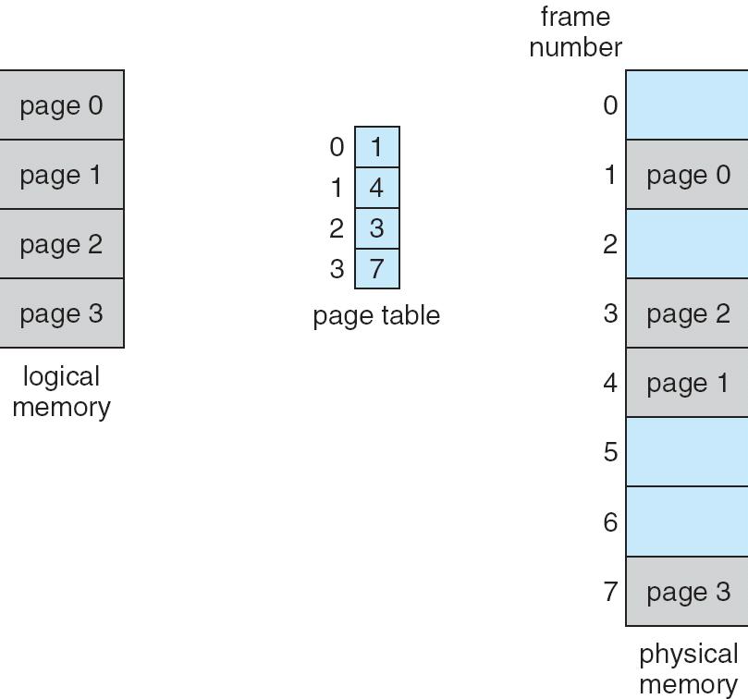
Second Memory Allocation: Paging
A memory-management scheme where the physical address space of a process can be noncontiguous
It is used in most operating systems.
Breaks the physical memory into fixed-sized blocks called frames.
Break the logical address space of process into blocks of the same size called pages.
Maps pages to frames

Slide 19

Paging
Usually, the size of physical memory frames is a power of 2, between 512 bytes and 16MB
To load a process of n logical pages, the OS must find n free frames (not necessarily contiguous) and load the process in those frames
A page table translates logical to physical addresses

Slide 20
Address Translation Scheme
Logical address space of a process is 2^{m} and the logical address space of a page is 2^{n}
Addresses generated by CPU, which are in the range between 0 and 2^{m} ,such as (1010110011) are divided into:
Page number (p): m-n bits (1010110011) used as an index into a page table which contains base address of each page in physical memory
Page offset (d): n bits (1010110011) combined with base address to define the physical memory address that is sent to the memory unit

Slide 21
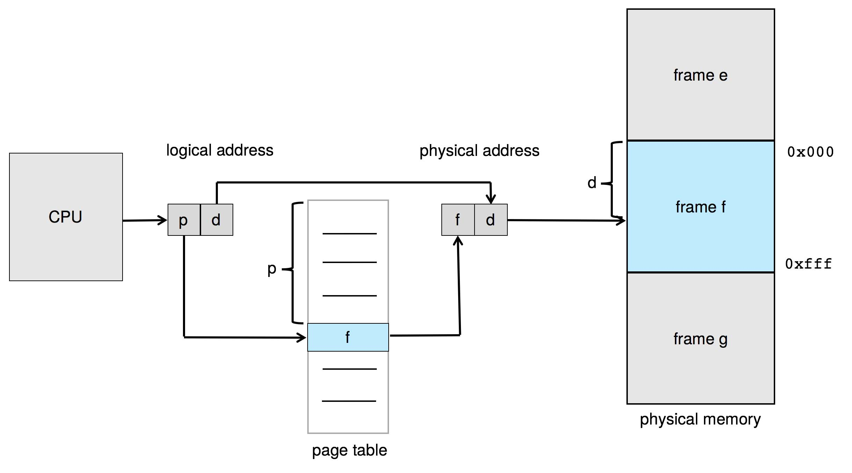
Paging Hardware
Logical address space of a process: 2^{m} Logical address space of a page: 2^{n}

Slide 22

Paging Example
Example:
m=4, thus logical address space is 2⁴ = 16
Page size 4 bytes, thus n = 2
A physical memory of 32 bytes, thus 8 frames
What is the physical address of logical address 13?
13 → 1101
Page number = the first m-n bits:11 = 3
Page offset = the last n bits: 01
Physical address is 1001 = 9
Information about the frame where page 3 is stored is in entry 3 of the page table
Entry 3 of page table said that page 3 is stored is frame 2
Take the first address of frame 2 (which is 8) + offset (which is 1), 8 + 1 = 9

Slide 23
Implementation of Page Table
Two CPU registers
Page-table base register (PTBR) stores the address of the page table in main memory
Page-table length register (PTLR) stores size of the page table
Once the CPU fetches the address of the next instruction from the program counter register
The m – n bits of this address are used as an offset into the page table
This offset is combined with the contain of the PTBR register to find the address of the frame where the instruction fetches from the program counter can be found in physical memory

Slide 24
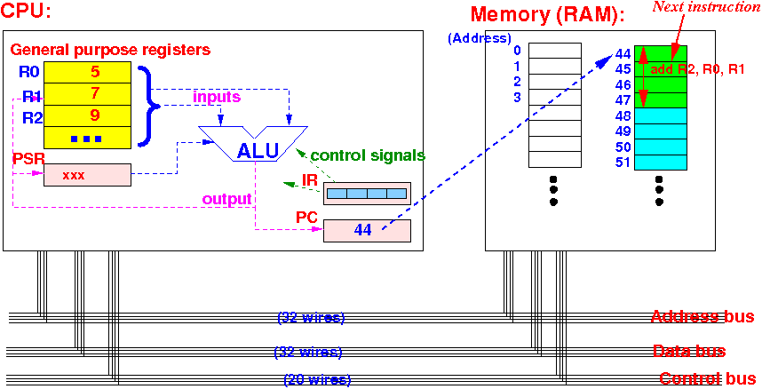
Problem with the Page Table
Page table is kept in main memory
Page-table base register (PTBR) points to the page table
Page-table length register (PTLR) indicates size of the page table
Every data/instruction access requires two memory accesses
One for the page table and one for the data / instruction
The two-memory access problem can be solved by the use of a special fast-lookup hardware cache called translation look-aside buffers (TLBs) (also called associative memory).

Slide 25
Hardware
Associative memory – parallel search
Address translation (p, d)
If p is in associative register, get frame # out
Otherwise get frame # from page table in memory

Slide 26

Paging Hardware With TLB

Slide 27
Implementation of TLB
Some TLBs store address-space identifiers (ASIDs) in each TLB entry – uniquely identifies each process for the contain of a frame.
ASIDs provide address-space protection for that process as the logical page must match the process. If not, treated as a TLB miss
ASIDs also allow to store in the same TLB the page frame of several processes
If no ASID, every time a new page table is selected (following a process context switch), the TLB must be flushed

Slide 28
Effective Access Time
Hit ratio – percentage of times that a page number is found in the TLB
An 80% hit ratio means that we find the desired page number in the TLB 80% of the time.
Suppose that 10 nanoseconds to access memory.
If we find the desired page in TLB then a mapped-memory access take 10 ns
Otherwise we need two memory access so it is 20 ns
Effective Access Time (EAT)
EAT = 0.80 x 10 + 0.20 x 20 = 12 nanoseconds
implying 20% slowdown in access time
Consider a more realistic hit ratio of 99%,
EAT = 0.99 x 10 + 0.01 x 20 = 10.1ns
implying only 1% slowdown in access time.

Slide 29
Memory protection
The size of the logical address space of a process is a power of 2, such as 2^{m} where m is the number of bits needed to address an instruction
However, the size of a process does not have to be exactly 2^{m} , the real size may just be 2^{m-1} +1 bytes, so the addresses from 2^{m-1} +1 to 2^{m} simply do not exist in the process
Nonetheless, the page table which size 2^{m-n} , will have entries for pages that do not exist in a process
Example:
let a process size to be 33 bytes. We need 6 bits to address 33 different bytes, thus m = 6. Let a page size be 8 bytes, i.e. 2³ , thus n = 3.
The number of entries in the page table is 2^{m-n} = 2⁶⁻³ = 8
Thus, the page table has 8 entries, but the process size is 5 pages, with the last page containing only 1 byte.
So, what to do with the entries in the page table that do not map any page to a frame?

Slide 30

Memory Protection
Memory protection implemented by associating protection bit with each frame to indicate if read-only or read-write access is allowed
Valid-invalid bit attached to each entry in the page table:
“valid” indicates that the associated page is in the process’ logical address space, and is thus a legal page
“invalid” indicates that the page is not in the process’ logical address space
Or use page-table length register (PTLR)
Any violations result in a trap to the kernel

Slide 31
Valid (v) or Invalid (i) Bit In Page Table
Suppose a system with 14-bit address space.
Page size is 2 KB (11 bits).
Page table has 2⁽¹⁴⁻¹¹⁾ =8 pages.
A program uses addresses 0 to 10468.
Require 10468 / 2¹¹ = 5.11 → 6 frames.
(The internal fragmentation problem: Not all references to page 5 are valid)

Slide 32
Reentrant code
A piece of code is considered reentrant if two tasks can be running in the code at the same time without behaving incorrectly
i.e. the code can be re-entered while it is already running (i.e. it can be safely executed concurrently)
A reentrant code must:
hold no static (or global) non-constant data.
work only on the data provided to it by the caller.
32
Notes:
32

Slide 33
Threads here are not reentrant
int sum;
void *runner(void *param);
int main(int argc, char *argv[]){
pthread_t tid;
pthread_t tid3 = syscall(SYS_gettid);
pthread_create(&tid, &attr, runner, argv[1]);
pthread_join(tid,NULL);
pthread_exit(0);
}
void *runner(void *param) {
int i, upper = atoi(param);
sum = 0;
for (i = 1; i <= upper; i++)
sum += i;
pthread_exit(0);
}
33
Notes:
33

Slide 34
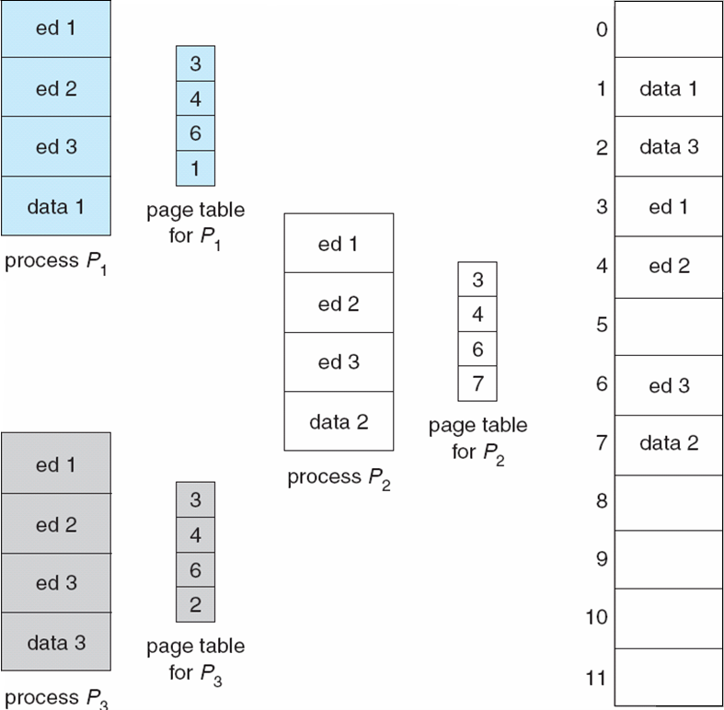
Shared Pages
Shared code
One copy of read-only (reentrant) code shared among processes (i.e., text editors, compilers, system libraries (libc))
Consider a system where 40 users execute a text editor.
If the text editor consists of 150 KB of code and 50 KB of data space, we need 8,000 KB to support the 40 users.
Paging makes the common code sharing easier.
If the code is reentrant (pure) code, its pages can be shared.

Slide 35
Structure of the Page Table
Memory structures for paging can get huge using straight-forward methods
Consider a 32-bit logical address space
Page size of 4 KB (2¹²)
Page table would have 1 million entries (2³² / 2¹²)
If each entry is 4 bytes ➔ each process has 4 MB of physical address space for the page table alone
Don’t want to allocate that contiguously in main memory
One simple solution is to divide the page table into smaller units
Hierarchical Paging
Hashed Page Tables
Inverted Page Tables

Slide 36

Hierarchical Page Tables
Break up the logical address space into multiple page tables
A simple technique is a two-level page table
Break the page table into pages, then map each page to a different frame

Slide 37
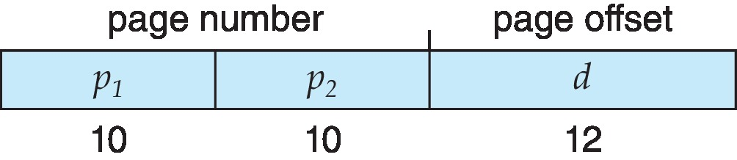
Two-Level Paging Example
A logical address (on 32-bit machine with 4K page size) is divided into:
a page number consisting of 20 bits
a page offset consisting of 12 bits
Since the page table is paged, the page number is further divided into:
a 10-bit page number (4 bytes per entry →1024 entries = 2^10)
a 10-bit page offset
Thus, a logical address is as follows:
where p₁ is an index into one of the 2^10 entries of the outer page table, and p₂ is the displacement within the page of the inner page table
Known as forward-mapped page table

Slide 38

Address-Translation Scheme
Here the outer page table has 1024 entries (2^10), each entry is 4 bytes long
Each entry contains the address of a frame that hold one page of the inner page table
Each entry of an inner page contains the address of a frame that stores a page of the process

Slide 39
Hashed Page Tables
Common in address spaces > 32 bits
The virtual page number is hashed into an entry of the page table
This entry contains a chain of elements hashing to the same location
Each element contains (1) the virtual page number (2) the value of the mapped page frame (3) a pointer to the next element
Virtual page numbers are compared in this chain searching for a match
If a match is found, the corresponding physical frame is extracted
Variation for 64-bit addresses is clustered page tables
Similar to hashed but each entry refers to several pages (such as 16) rather than 1
Especially useful for sparse address spaces (where memory references are non-contiguous and scattered)

Slide 40

Hashed Page Table

Slide 41
Inverted Page Table
Rather than each process having a page table and keeping track of all possible logical pages, track all physical pages (frames)
One entry for each frame
Entry consists of the virtual address of the page stored in that real memory location, with information about the process that owns that page
Decreases memory needed to store each page table, but increases time needed to search the table when a page reference occurs
Use hash table to limit the search to one — or at most a few — page-table entries
TLB can accelerate access
But how to implement shared memory?
One mapping of a virtual address to the shared physical address

Slide 42

Inverted Page Table Architecture

Slide 43
Third Memory Allocation: Segmentation
Memory-management scheme that supports user view of memory
A program is a collection of segments
A segment is a logical unit such as:
main program
procedure
function
method
object
local variables, global variables
common block
stack
symbol table, arrays

Slide 44
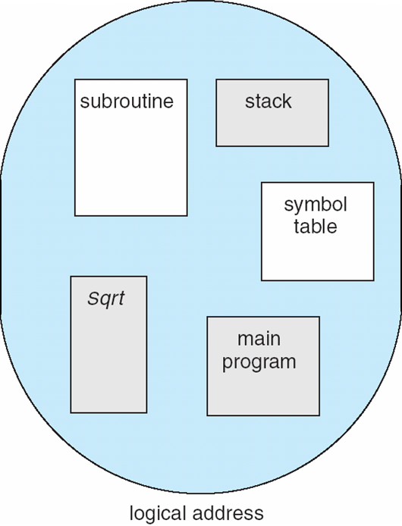
User’s View of a Program

Slide 45
Logical View of Segmentation
1
1
4
2
3
4
2
3
user space
physical memory space
Each segment is stored contiguously in the physical memory

Slide 46
Segmentation Architecture
Logical address consists of a two tuple:
<segment-number, offset>,
Segment table – maps two-dimensional physical addresses; each table entry has:
base – contains the starting physical address where the segments reside in memory
limit – specifies the length of the segment

Slide 47
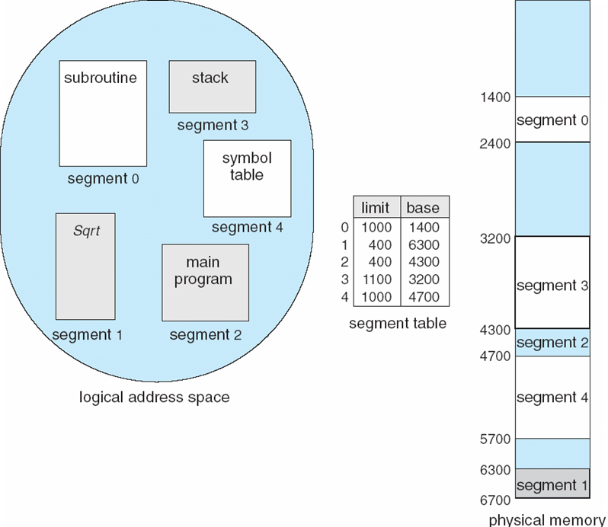
Example of Segmentation

Slide 48
Segmentation Architecture
Segment-table base register (STBR) points to the segment table’s location in memory
Segment-table length register (STLR) indicates number of segments used by a program;
segment number s is legal if s < STLR

Slide 49
Segmentation Architecture (Cont.)
Protection
With each entry in segment table associate:
validation bit = 0 ⇒ illegal segment
read/write/execute privileges
Protection bits associated with segments; code sharing occurs at segment level
Since segments vary in length, memory allocation is a dynamic storage-allocation problem (if not using paging)

Slide 50
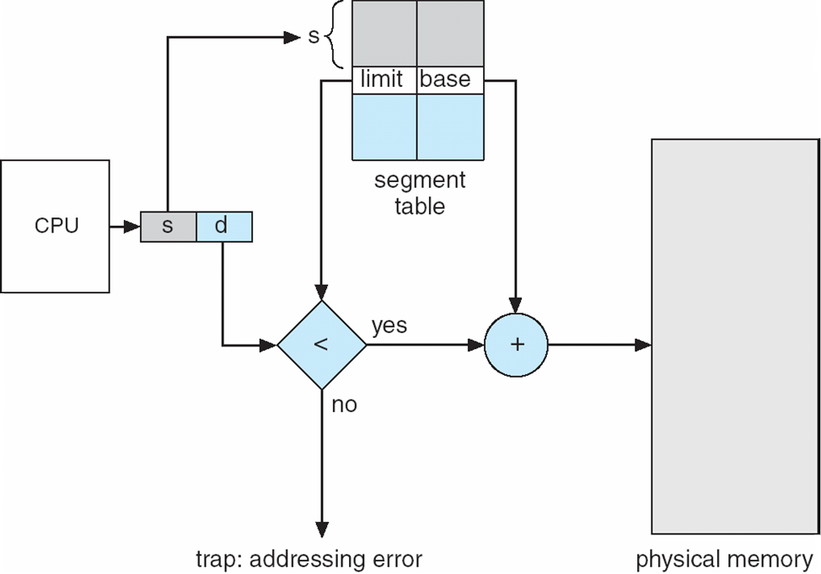
Segmentation Hardware

Slide 51
Example: The Intel IA-32 Architecture
Supports both segmentation and segmentation with paging
Each segment can be 4 GB
Up to 16 K segments per process
Divided into two partitions
First partition of up to 8 K segments are private to process (kept in local descriptor table (LDT))
Second partition of up to 8K segments shared among all processes (kept in global descriptor table (GDT))

Slide 52
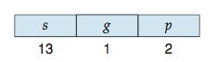
Example: The Intel IA-32 Architecture (Cont.)
CPU generates logical address which consists of the “selector” and the offset
The selector is as follow:
s is segment number, g is the segment table, p is for protection
The linear address is formed by adding the offset to the base address of the segment (which is hold in the segment entry in the appropriate segment table)
Linear address is given to paging unit
Which generates physical address in main memory
Paging units form equivalent of MMU
Pages sizes can be 4 KB or 4 MB

Slide 53
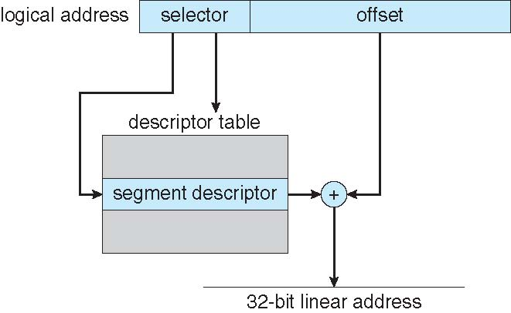
Intel IA-32 Segmentation

Slide 54
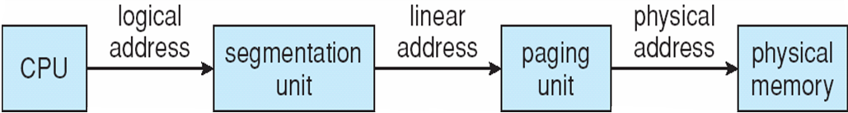
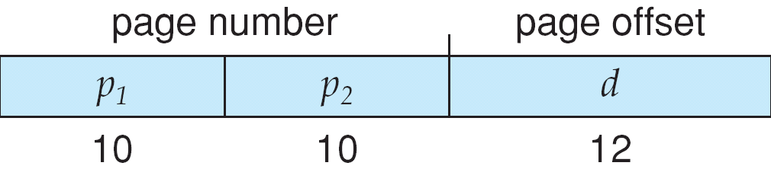
Logical to Physical Address Translation in IA-32

Slide 55
Swapping
A process can be swapped temporarily out of memory to a backing store, and then brought back into memory for continued execution
Total physical memory space of processes can exceed physical memory
Backing store – fast disk large enough to accommodate copies of all memory images for all users; must provide direct access to these memory images
Roll out, roll in – swapping variant used for priority-based scheduling algorithms; lower-priority process is swapped out so higher-priority process can be loaded and executed
Major part of swap time is transfer time; total transfer time is directly proportional to the amount of memory swapped
System maintains a ready queue of ready-to-run processes which have memory images on disk

Slide 56

Schematic View of Swapping

Slide 57
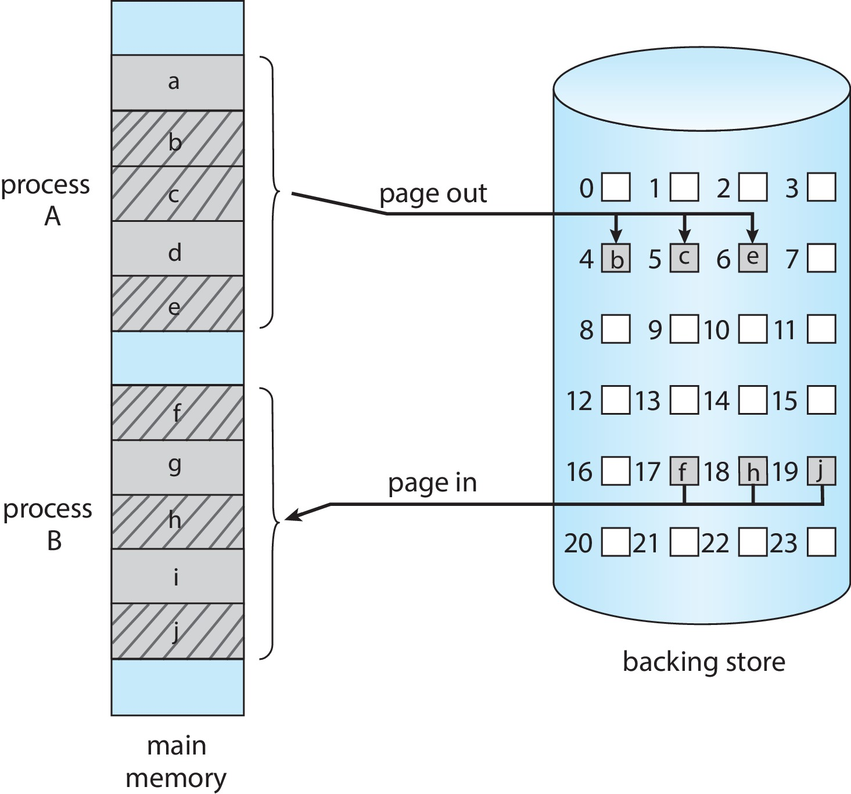
Swapping with Paging

Slide 58
Swapping (Cont.)
Does the swapped out process need to swap back in to same physical addresses?
Depends on address binding method
Plus consider pending I/O to / from process memory space
Modified versions of swapping are found on many systems (i.e., UNIX, Linux, and Windows)
Swapping normally disabled
Started if more than threshold amount of memory allocated
Disabled again once memory demand reduced below threshold

Slide 59
Context Switch Time including Swapping
If next process to be put on CPU is not in memory, need to swap out a process and swap in target process
Context switch time can then be very high
100MB process swapping to hard disk with transfer rate of 50MB/sec
Swap out time of 2000 ms
Plus swap in of same sized process
Total context switch swapping component time of 4000ms (4 seconds)
Can reduce if reduce size of memory swapped – by knowing how much memory really being used
System calls to inform OS of memory use via request_memory() and release_memory()

Slide 60
Context Switch Time and Swapping (Cont.)
Other constraints as well on swapping
Pending I/O – can’t swap out as I/O would occur to wrong process
Or always transfer I/O to kernel space, then to I/O device
Known as double buffering, adds overhead
Standard swapping not used in modern operating systems
But modified version common
Swap only when free memory extremely low

Slide 61
Exercises
1- Consider a logical address space of 64 pages of 1,024 words each, mapped onto a physical memory of 32 frames.
How many bits are there in the logical address?
How many bits are there in the physical address?
2- Consider a logical address space of 2,048 pages with a 4-KB page size, mapped onto a physical memory of 512 frames.
How many bits are required in the logical address?
How many bits are required in the physical address?
3- Given six memory partitions of 300 KB, 600 KB, 350 KB, 200 KB, 750 KB, and 125 KB (in order), how would the first-fit, best-fit, and worst-fit algorithms place processes of size 115 KB, 500 KB, 358 KB, 200 KB, and 375 KB (in order)?
4 Given six memory partitions of 100 MB, 170 MB, 40 MB, 205 MB, 300 MB, and 185 MB (in order), how would the first-fit, best-fit, and worst-fit algorithms place processes of size 200 MB, 15 MB, 185 MB, 75 MB, 175 MB, and 80 MB (in order)? Indicate which—if any—requests cannot be satisfied

Slide 62
Exercises
4- Assuming a 1-KB page size, what are the page numbers and offsets for
the following address references (provided as decimal numbers):
a. 3085 b. 42095 c. 215201 d. 650000 e. 2000001
Solution 3085: divide 3085 by 1024 to find out how many logical pages are there (4 in this case) and also how many bits are needed to represent the entries of the page table.
Convert logical address from Decimal to Binary 3085 = 110000001101. We need 2 bits, so 11 indicate the entry in the page table.
The next 10 bits are the offset 0000001101 in decimal is 13
Consider a paging system with the page table stored in memory.
a. If a memory reference takes 50 nanoseconds, how long does a paged memory reference take?
b. If we add TLBs, and if 75 percent of all page-table references are found in the TLBs, what is the effective memory reference time? (Assume that finding a page-table entry in the TLBs takes 2 nanoseconds, if the entry is present.)
EAT= %TLB success * 50 + %TLB fail *100 + TLB search
What is the purpose of paging the page tables?

Slide 63
End of Section 9

